Slide 1
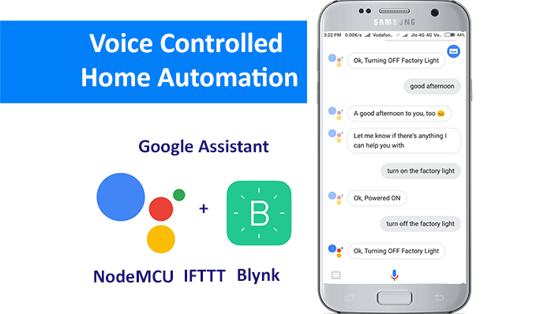

VOIS Fortech
Home Automation using Google Assistants

Slide 2
Group name & No:- AIsoft 391 Mentor:-Monalisa Mam Home Automation using Google Assistant submitted to:-Monalisa mam submitted by:- 1.Amarnath Jejurkar 2.Rushikesh Bhanvase 3.Aditya Mansukh 4.Nayan Choudhary 5.Abhishek Patil

Slide 3
sr.no | Title | Slide no
1. | Introduction | 4-5
2. | Technology use | 6-8
3. | Component use in project | 9
4. | Hardware and Software | 10-20
5. | Block Diagram | 21
6. | working | 22-23
7. | Thank you slide | 25

Slide 4
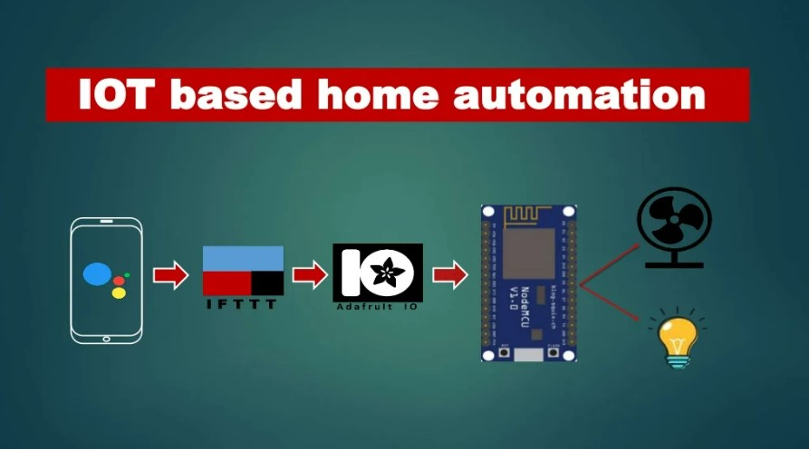

Slide 5
Introduction:- Home automation evolution starts with some basic ideas. it minimizes the human effort and it can be deployment in lot of field like miltary, surveillance application is developed in the modern world . Now days home automation is developed by using wireless technology in Home Automation start with Bluetooth, WIFI, and Zigbee communication. Based on the requirement, Application and online platform they deployed the communication in Project and we have numerous online platform in internet to control Home automation. ”Adafruit.com” is popular online platform used in project it has a lot of feature like buttons,gauges,sliders and plotting feature also. By using technology we can control number of Home automation to control it very useful for surveillance application. Now a days indoor localization Technology are developed on that case also we can deploy this type fo voice controlled Home automation

Slide 6
Technology:-
1.Internet of Things
2.Artificial Intelligence

Slide 7
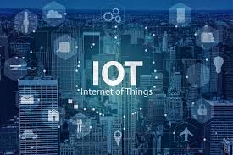
Internet of Things
The term IoT, or Internet of Things, refers to the collective network of connected devices and the technology that facilitates communication between devices and the cloud, as well as between the devices themselves.
An IoT ecosystem consists of web-enabled smart devices that use embedded systems, such as processors, sensors and communication hardware, to collect, send and act on data they acquire from their environments. IoT devices share the sensor data they collect by connecting to an IoT gateway or other edge device where data is either sent to the cloud to be analyzed or analyzed locally. Sometimes, these devices communicate with other related devices and act on the information they get from one another. The devices do most of the work without human intervention, although people can interact with the devices -- for instance, to set them up, give them instructions or access the data.

Slide 8

Artificial Intelligence (AI):-
Artificial intelligence is the simulation of human intelligence processes by machines, especially computer systems.
The theory and development of computer system able to perform task normally requiring human intelligence, such as visual perception, speech recognition, decision-making, and translation between languages..
Here we are using google Assistant for our project.

Slide 9
component :- Hardware:- 1.Nodemcu 2.Relay module 3.wires 4.Bulb Software:- 1.Arduino ide 2.Google assistant 3.Adafruit io 4.IFTTT

Slide 10
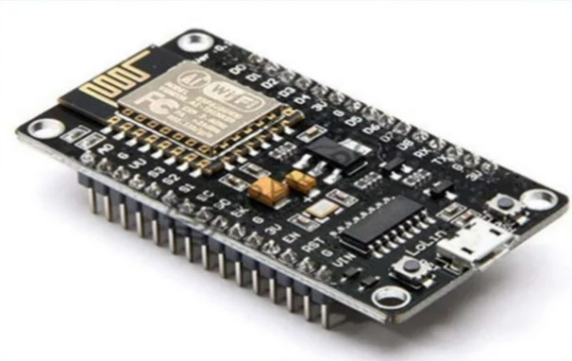
Hardware Component:-
Nodemcu

Slide 11
Nodemcu:- The nodemcu (node microcontroller unit) is an open-source software and hardware development environment built around an inexpensive system-on-a-chip (soc) called the esp8266. the esp8266, designed and manufactured by espressif systems, contains the crucial elements of a computer: cpu, ram, networking (wifi), and even a modern operating system and sdk. that makes it an excellent choice for internet of things (iot) projects of all kinds. however, as a chip, the esp8266 is also hard to access and use. you must solder wires, with the appropriate analog voltage, to its pins for the simplest tasks such as powering it on or sending a keystroke to the “computer” on the chip. you also have to program it in low-level machine instructions that can be interpreted by the chip hardware. this level of integration is not a problem using the esp8266 as an embedded controller chip in mass-produced electronics. it is a huge burden for hobbyists, hackers, or students who want to experiment with it in their own iot projects.

Slide 12
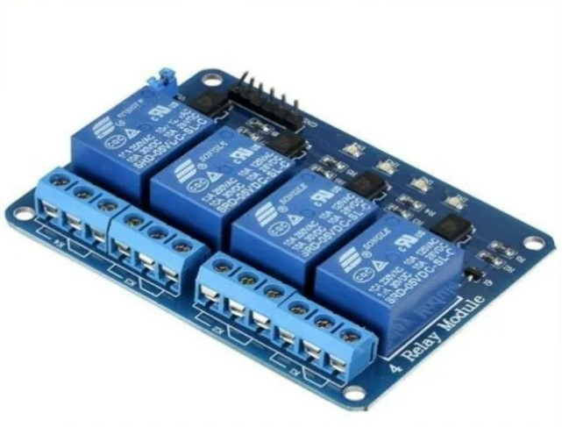
Relay Module

Slide 13
Relay module:- A power relay module is an electrical switch that is operated by an electromagnet. the electromagnet is activated by a separate low-power signal from a micro controller. when activated, the electromagnet pulls to either open or close an electrical circuit.

Slide 14
software:- 1. Arduino ide:- The arduino ide is an open-source software, which is used to write and upload code to the arduino boards. the ide application is suitable for different operating systems such as windows, macos x, and linux. it supports the programming languages c and c++. here, ide stands for integrated development environment

Slide 15
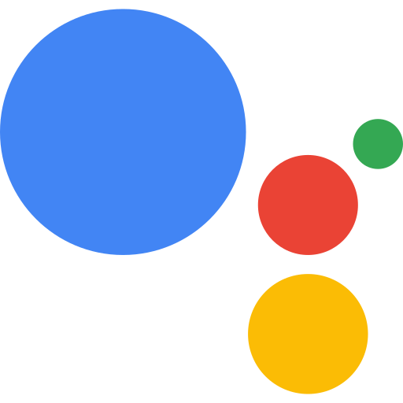
Google Assistant

Slide 16
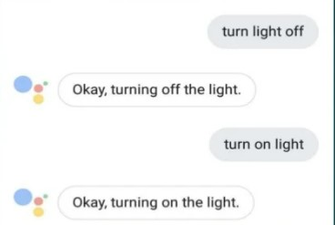
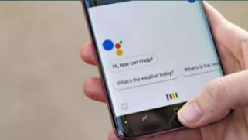
Google assistant :- Google assistant is AI (Artificial Intelligence) based voice command service . Using voice, we can interact with google assistant and it can search on the internet , schedule, event , set alarm, control appliances, etc. This service is available on smartphone and Google Home Devices. We can control smart home devices including lights switches fans and thermostatus using Google Assistant

Slide 17
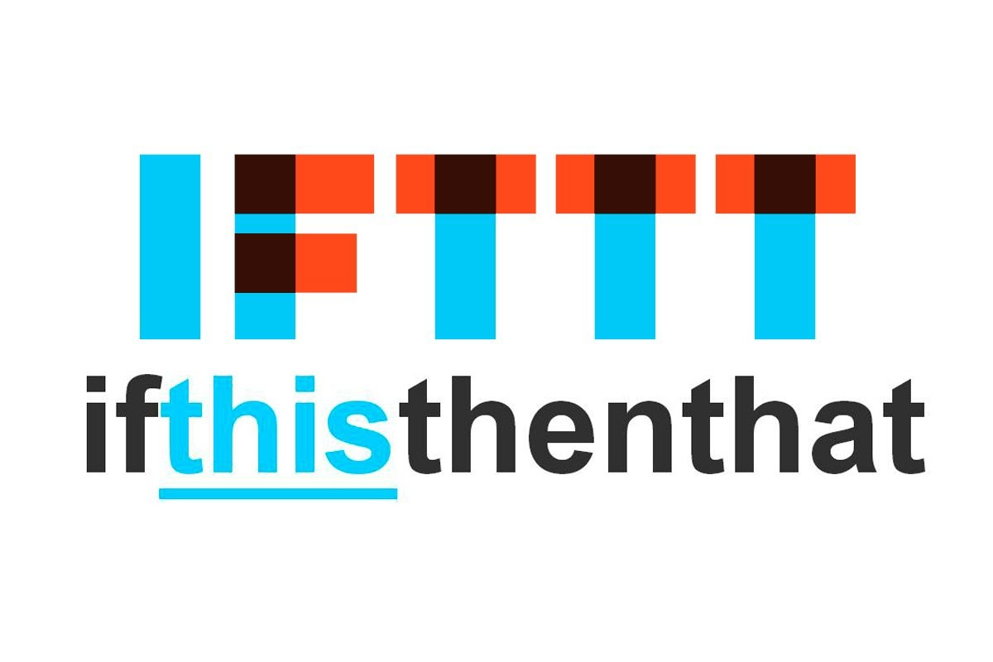
Online Platform
Adafruit IO
IFTTT

Slide 18
Adafruit
It is solution for the construction of application IOT created by Adafruit Industries, the well known open source hardware marketer, have created this platform for internet of things based platfrom known as Arduino Raspberry pi, Esp8266, Intel Galileo, Serial devices and wifi among others. The communication API is based on MQTT client with Adafruit servers.

Slide 19
IFTTT
If This Then That, also known as IFTTT is a free web based service to create chains of simple conditional statement , called applets. An applets is triggered by changes that occur within other web service such as Gmail, Facebook, Telegram, Instagram.
Here I used IFTTT to use google assistant service and adafruit service in chain. So , when I use google assistant to control light of my home by saving ok google google turn the light ON or OFF. Then IFTTT interpret the message and can send it to Adafruit dashboard as a understandable command to the created feed

Slide 20
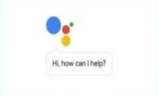

Block Diagram:-
Google Assistant
Adafruit
IFTTT
Bulb
Relay
Nodemcu

Slide 21
Working:- Working procedure: 1.for this project, first we need to collect all the equipment as required. 2.then connect them as like as circuit diagram. 3.then open "adafruit io "and open an account, make an applet. 4.write a for "nudemcu" by arduino-ide and load it into "nudemcu, and connect it with adafruit io. after that we can control home appliance by using smart phone from this online platforms but we can't control it by voice command. 5.that's why we need to install google assistant in our mobile and set up it. but till now we can't reach our goal. 6.so that we need to build communication into "adafruit" and google assistant. and we connect "adafruit" and google assistant by using ifttt. Result: after that we can control our home appliance by voice from anywhere of the world by voice command. conclusion: if we can implement this system in our home then our modern life will be more easier and more smarter.

Slide 22
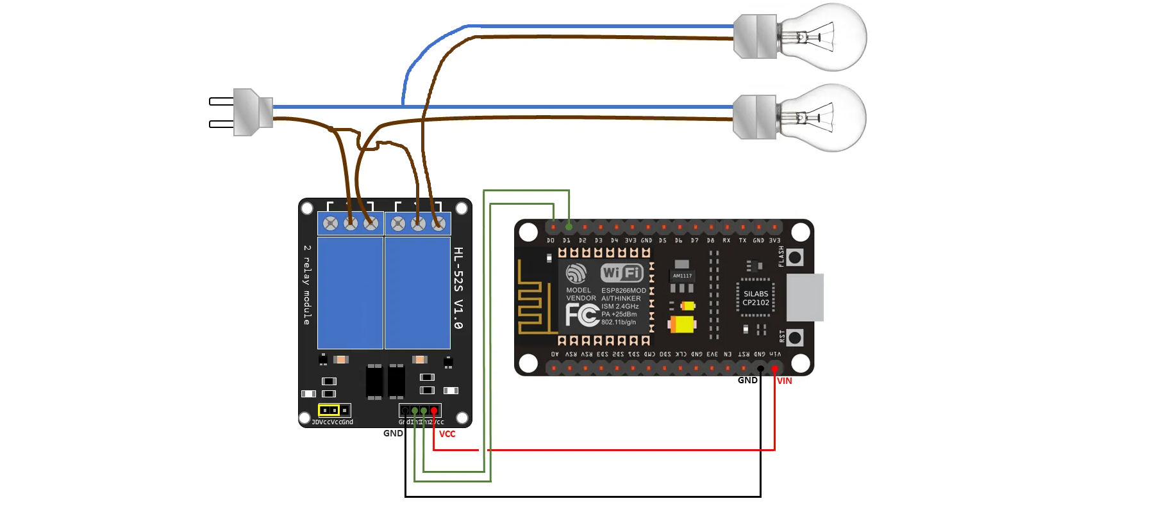
Diagram:-

Slide 23
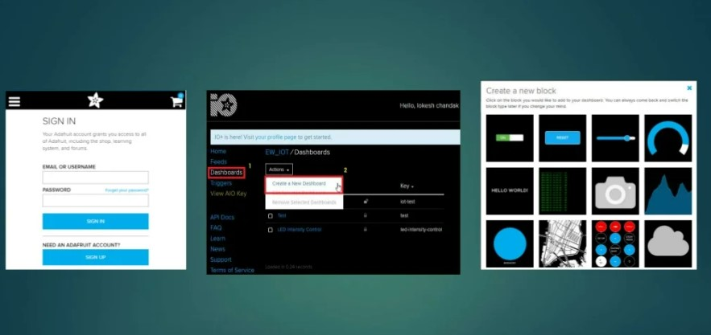

Slide 24

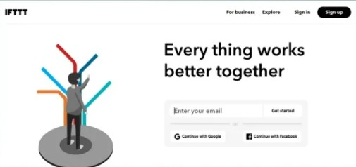

Slide 25
Benefits:- 1.savings 2.safety 3.convenience 4.control 5.comfort Future scope:- 1.Sensor Technology 2.Smart robotics appliances 3.Protection of connected devices 4.fault detection and feedback system

Slide 26
End user Interaction:- Smart home systems are considered one of the prominent applications in the era of internet of things (IOT), where it is possible to control home devices to achieve a better usage in terms of cost and convenience. IOT offers the internet connection and remote management of home automation, integrated with numerous sensors. System constitute to be an innovative and popular form of residence in the modern cities, therefore designers need to comply with users preferences and requirements

Slide 27


